Slide 2
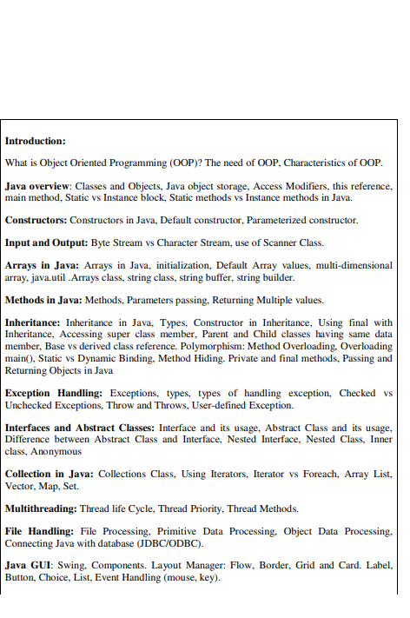

Slide 3
ArrayList class

Slide 4
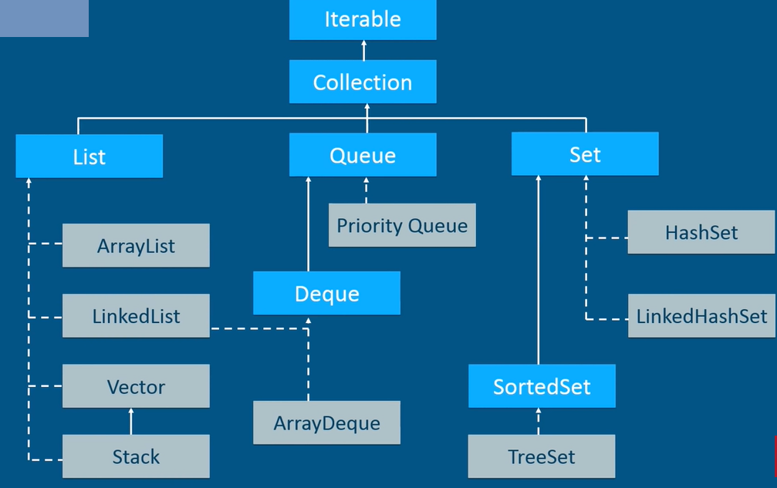

Slide 5
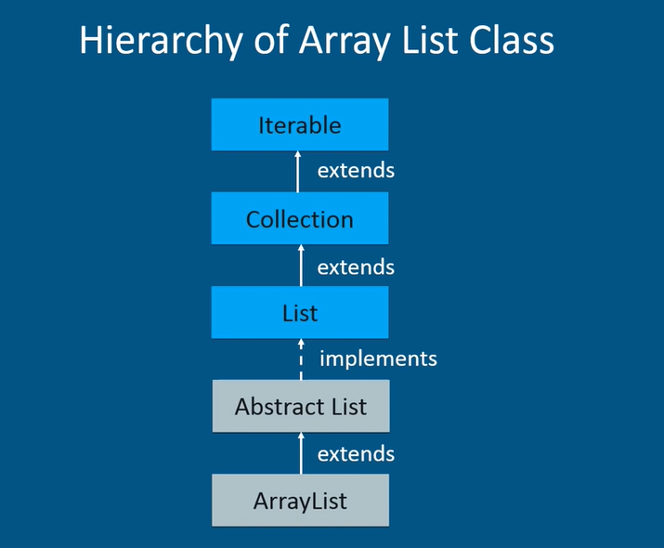

Slide 6
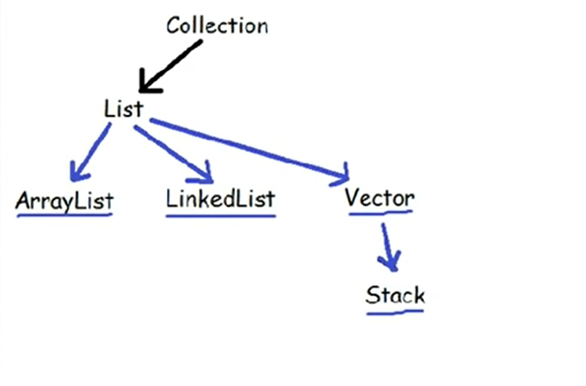

Slide 7
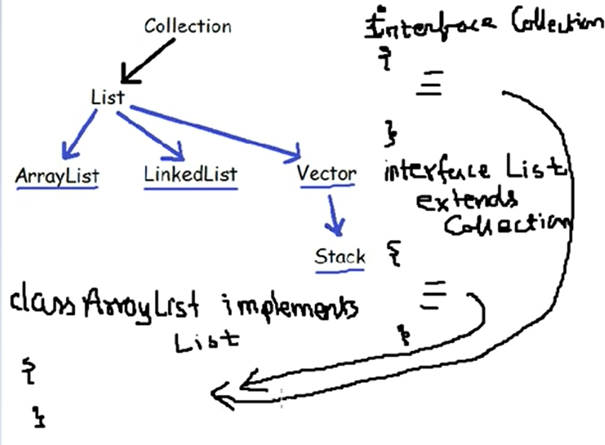

Slide 8
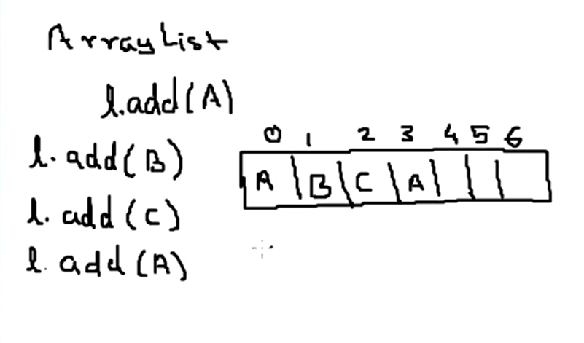

Slide 9
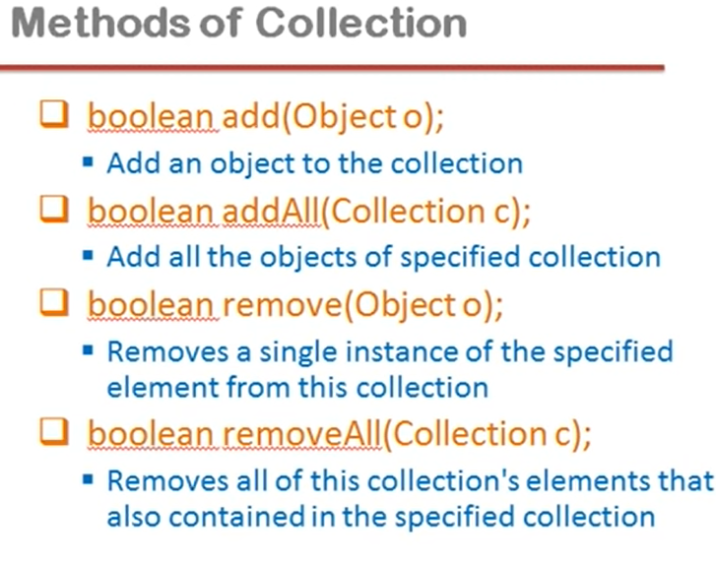

Slide 10
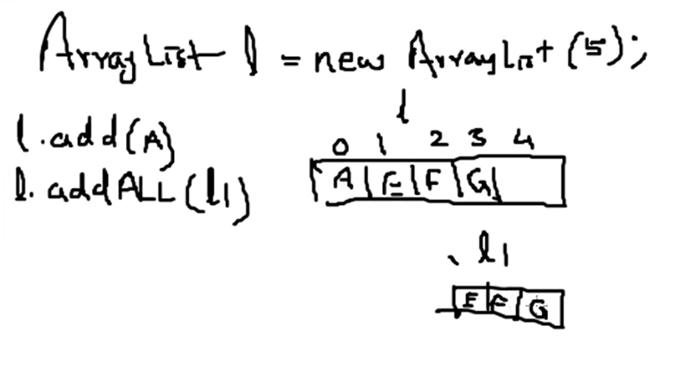

Slide 11
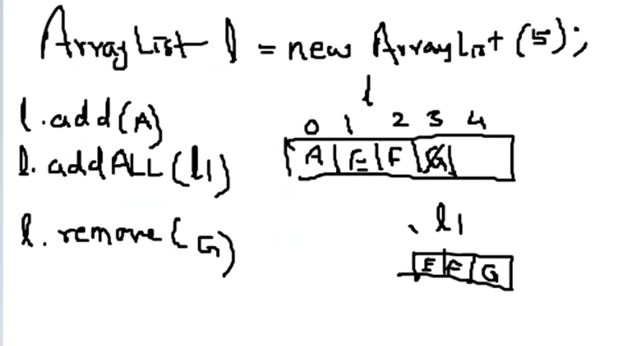

Slide 12
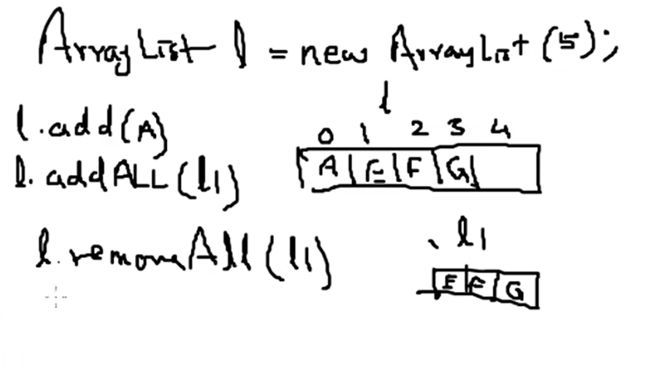

Slide 13
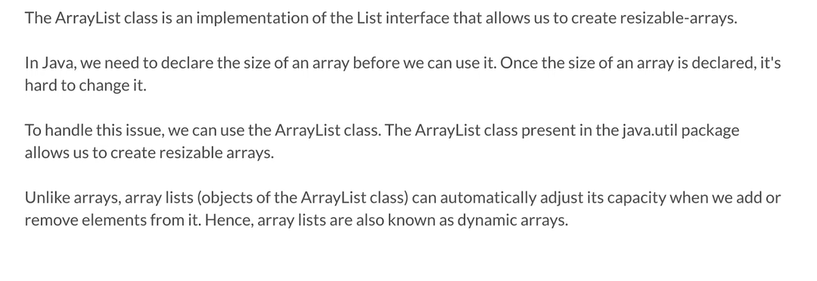

Slide 14
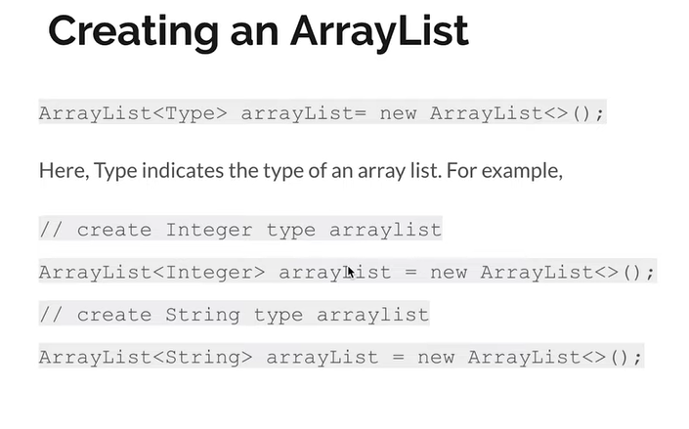

Slide 15
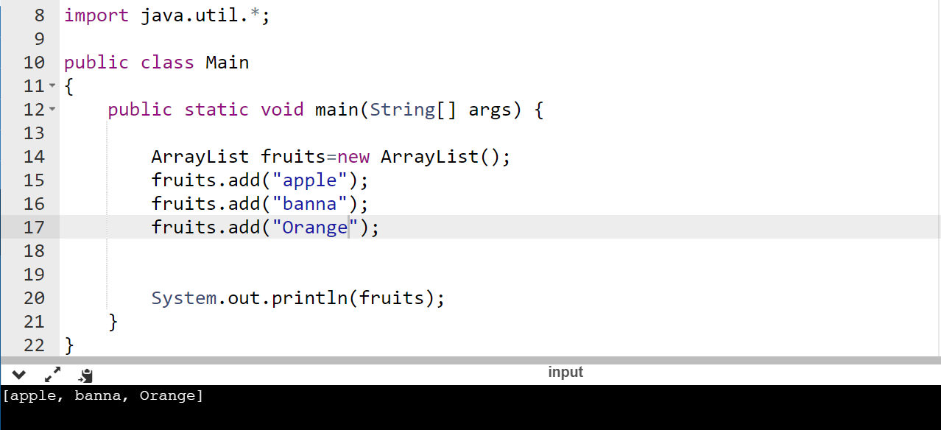

Slide 16
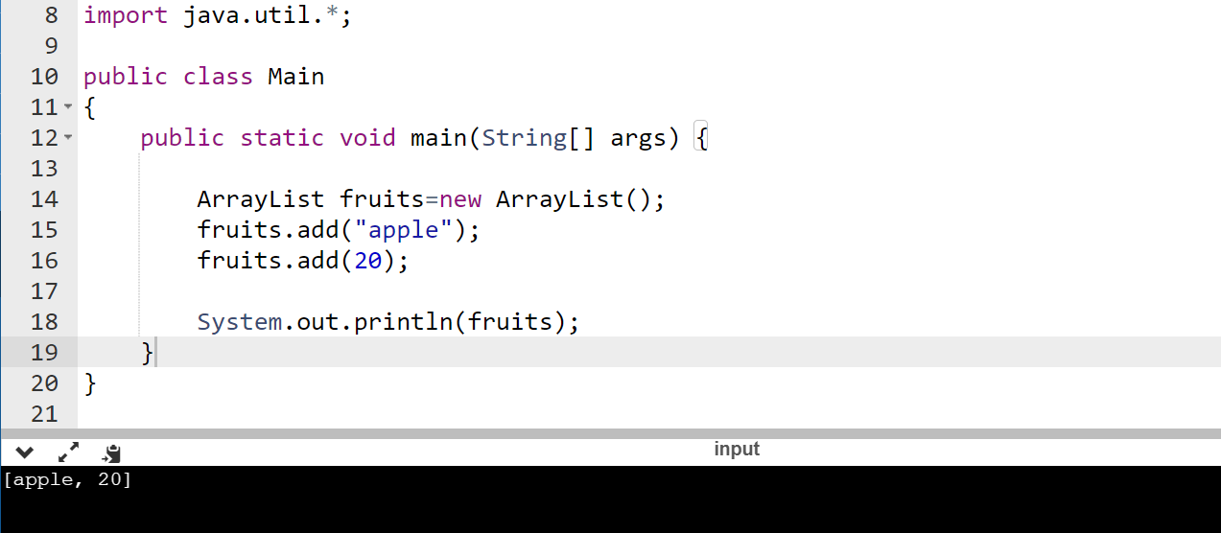

Slide 17
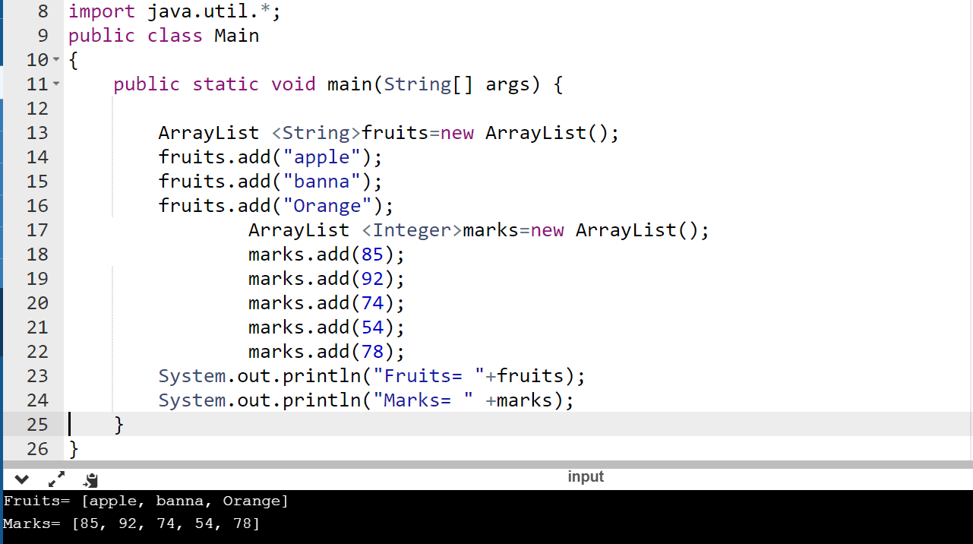

Slide 18
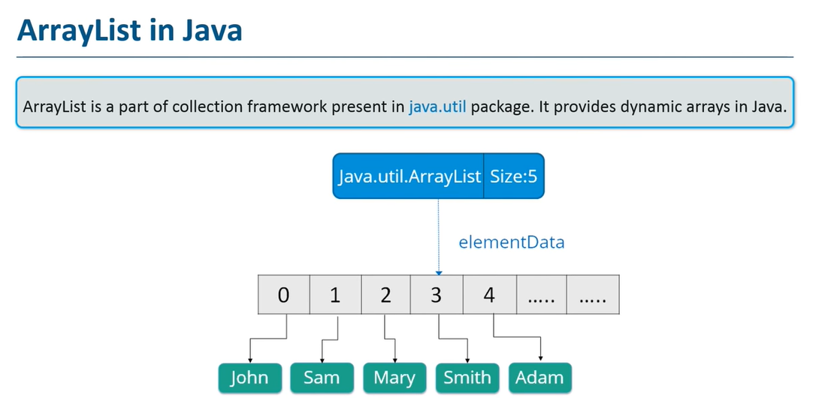

Slide 19
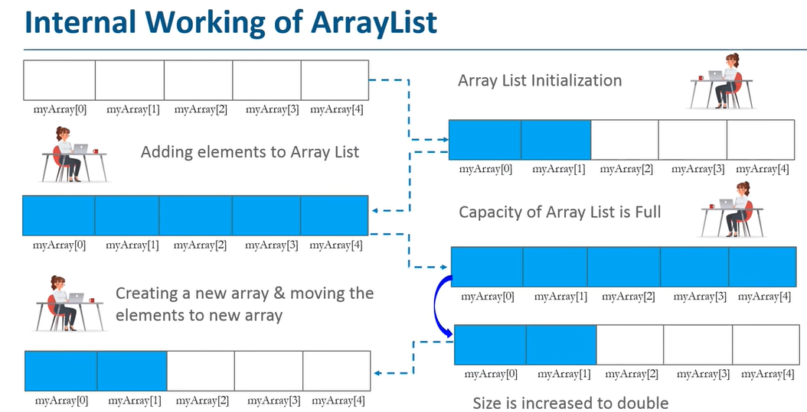

Slide 20
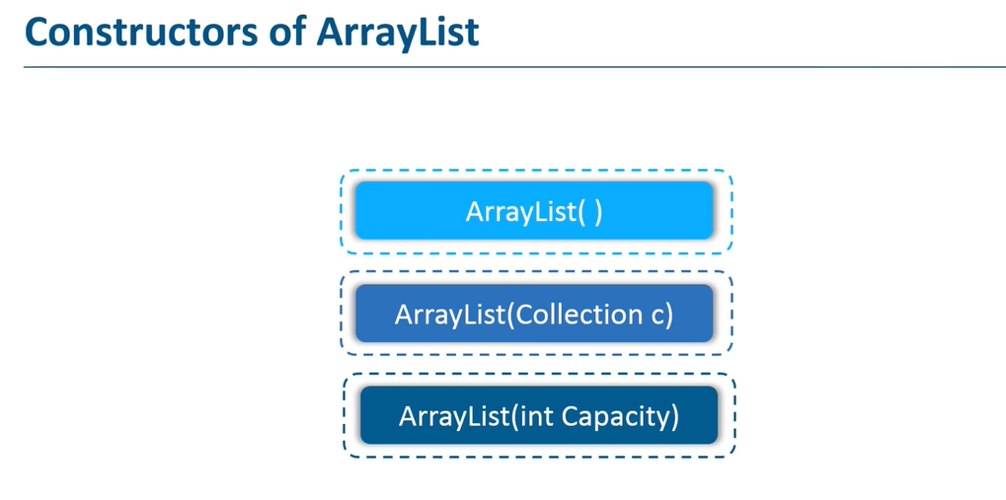

Slide 21
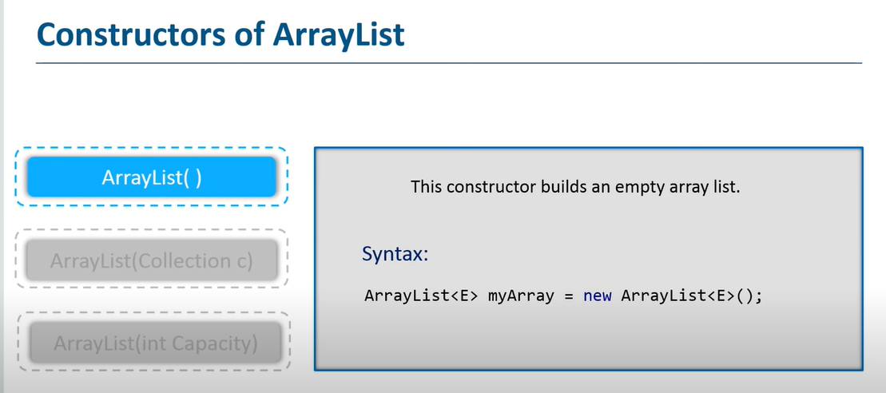

Slide 22
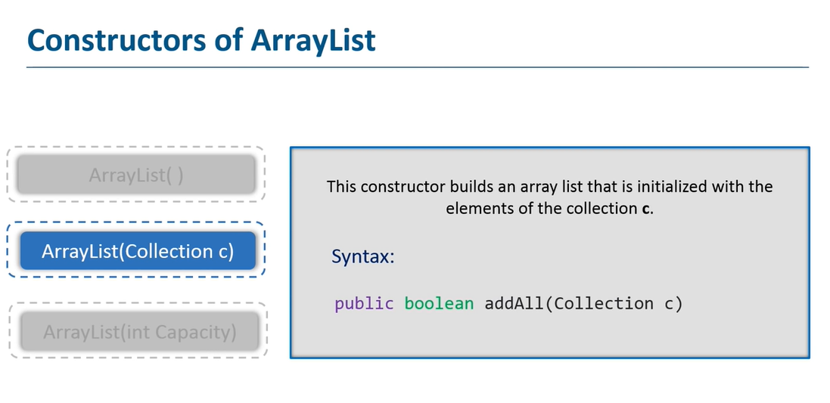

Slide 23
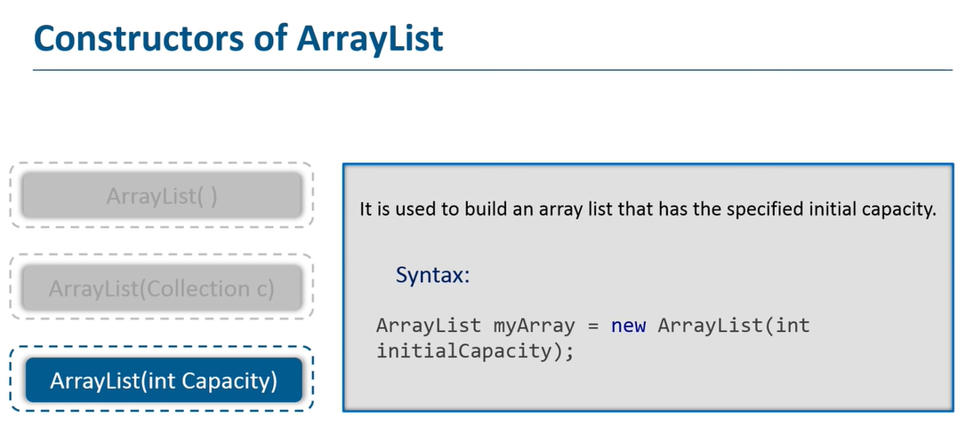

Slide 24


Slide 25
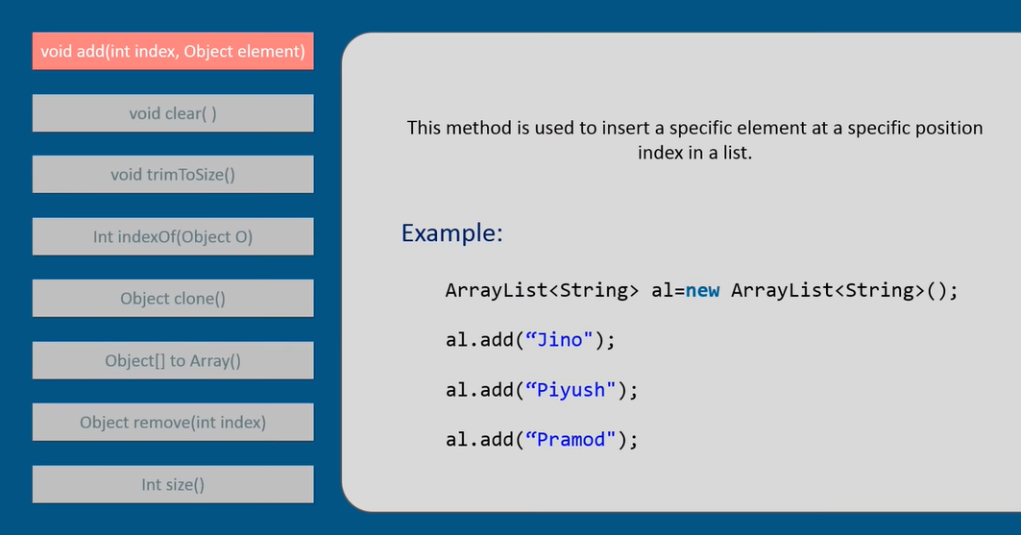

Slide 26
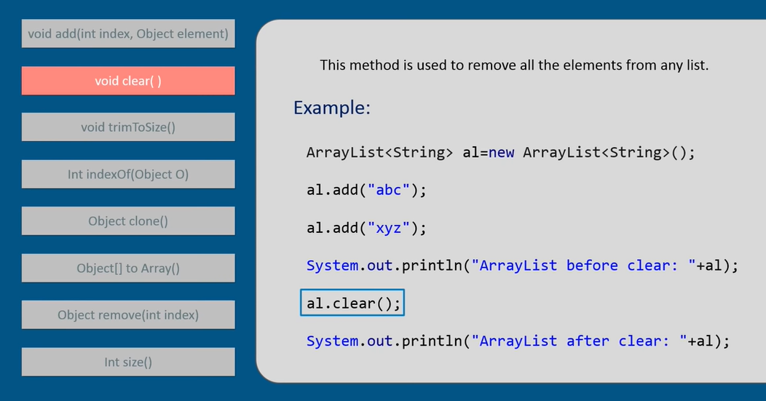

Slide 27
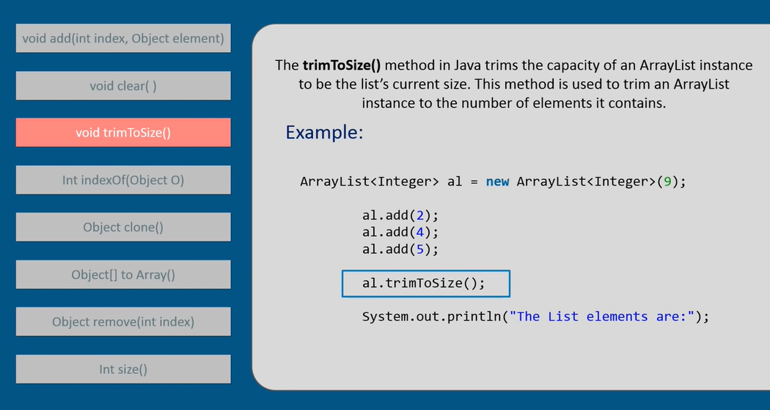

Slide 28
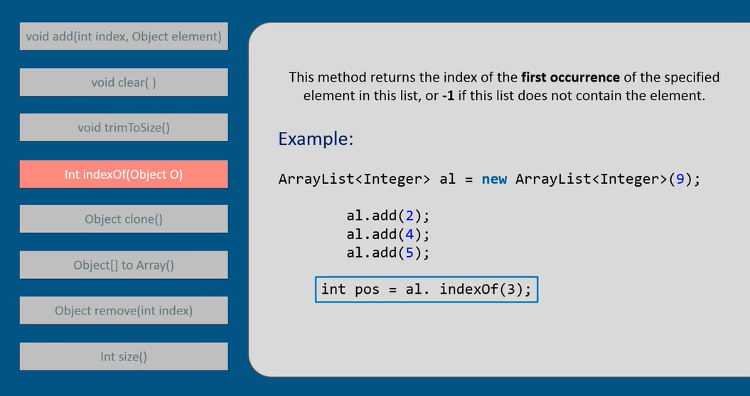

Slide 29
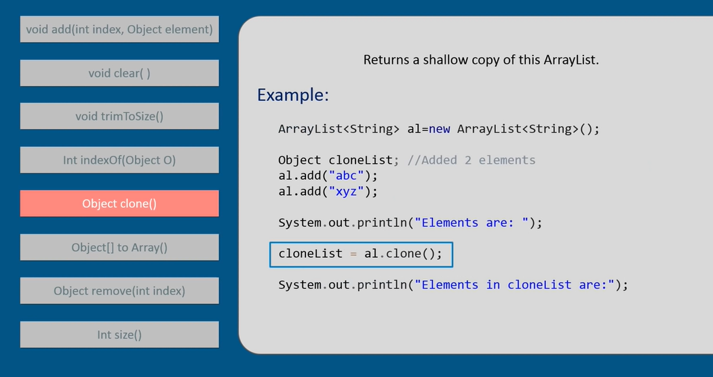

Slide 30
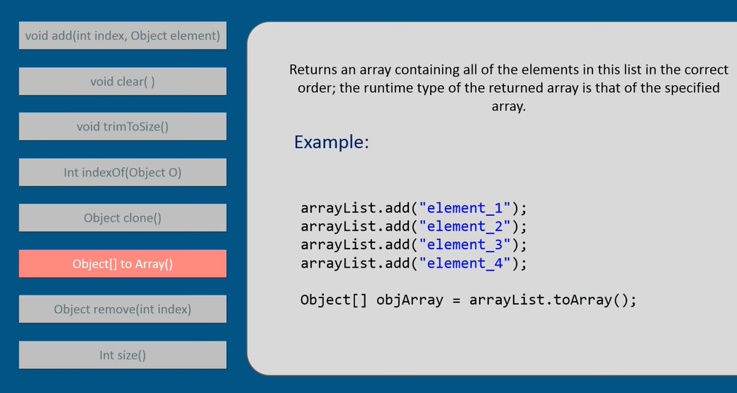

Slide 31
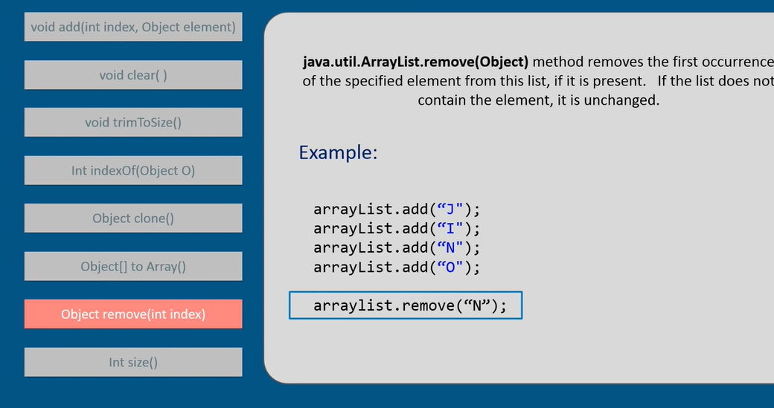

Slide 32
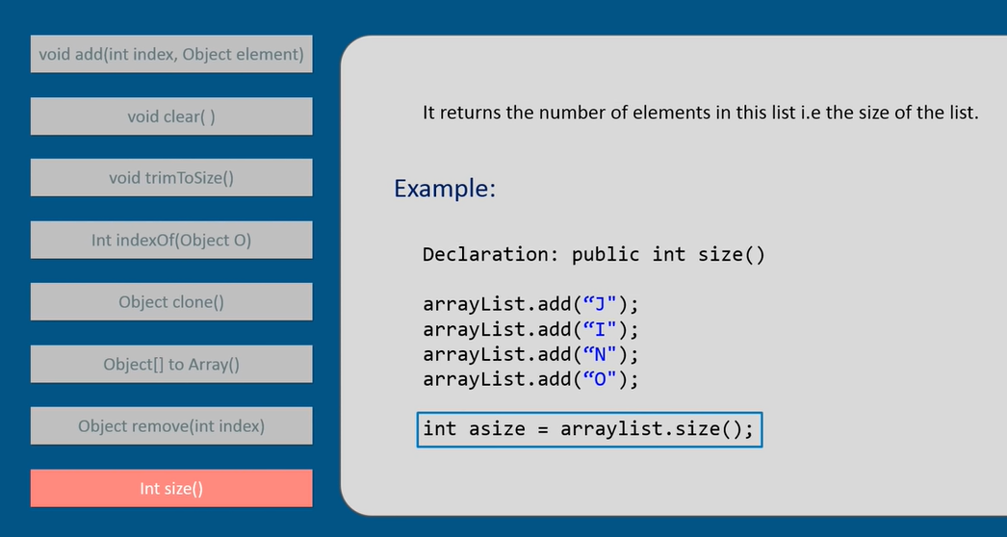

Slide 33
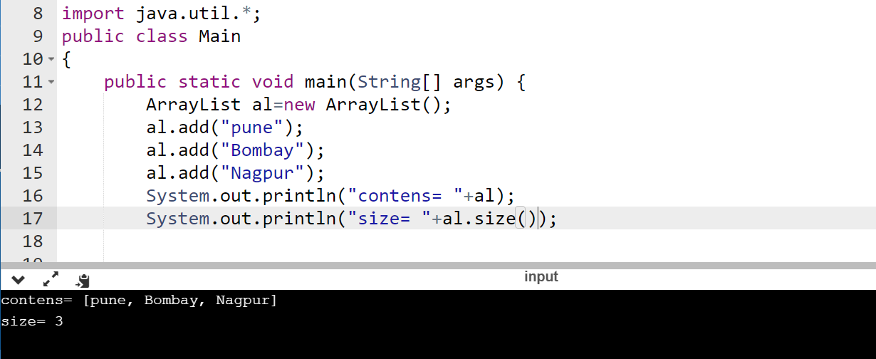

Slide 34
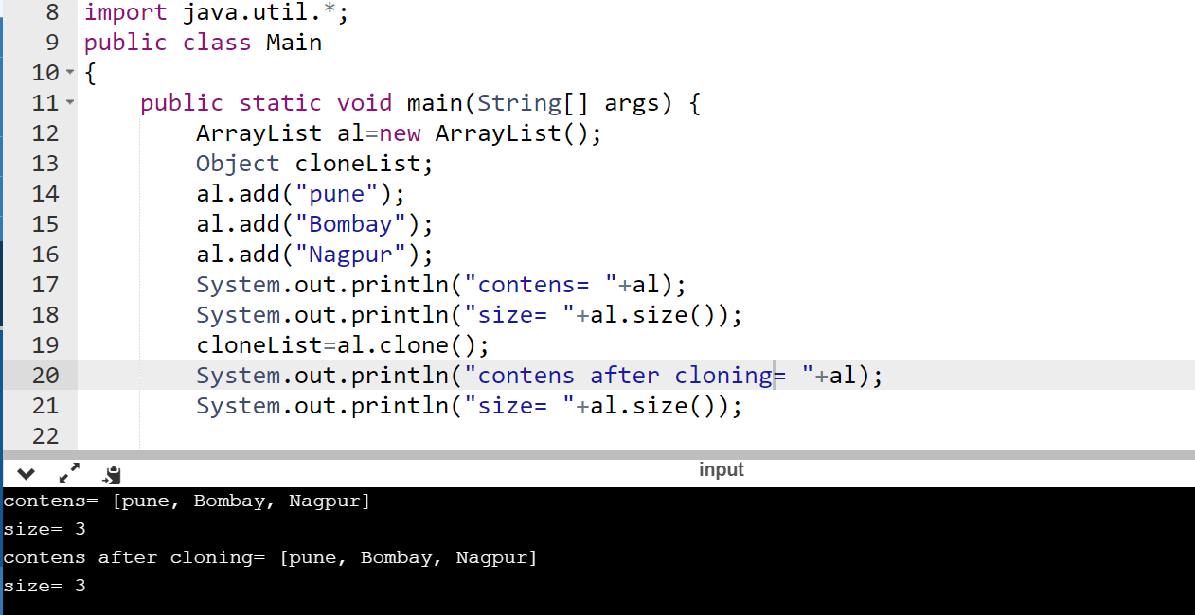

Slide 35
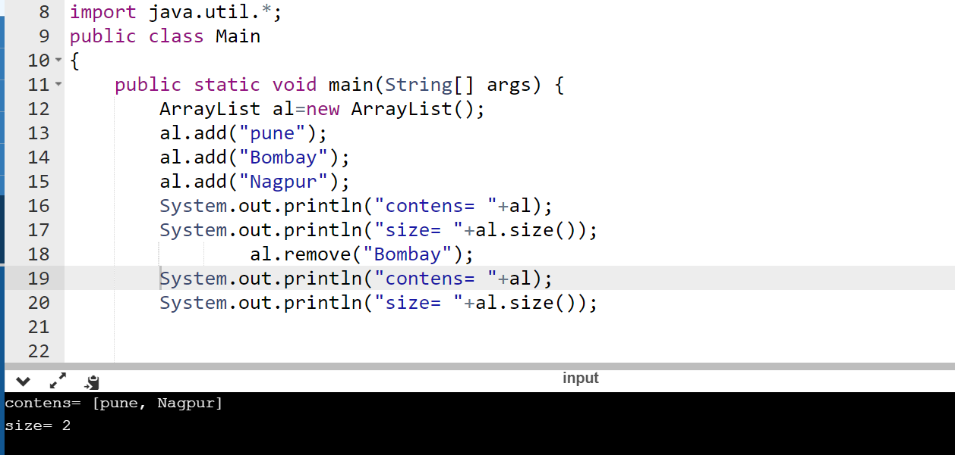

Slide 36
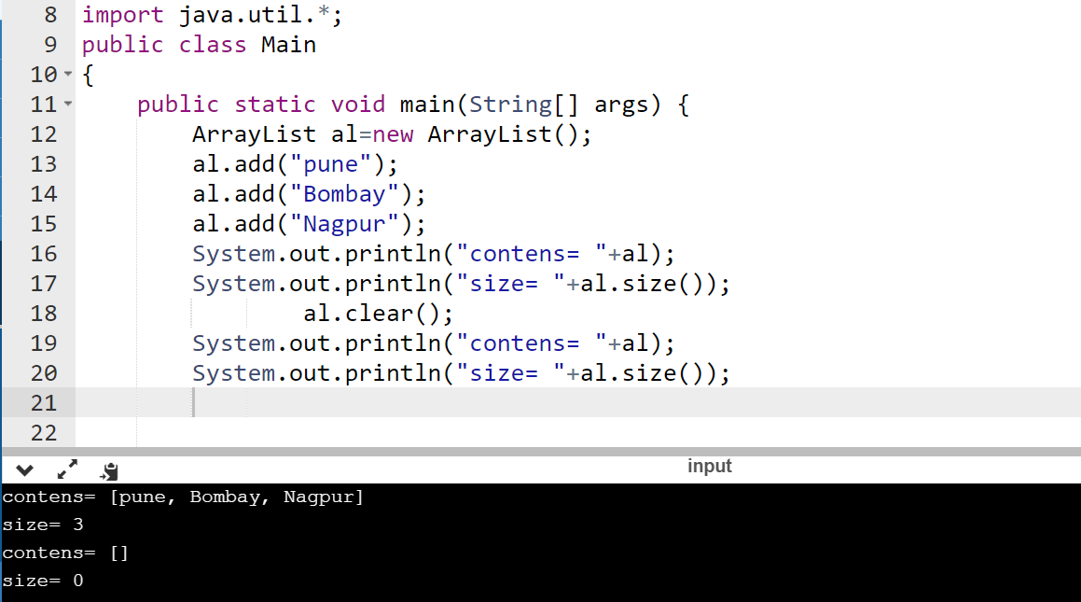

Slide 37
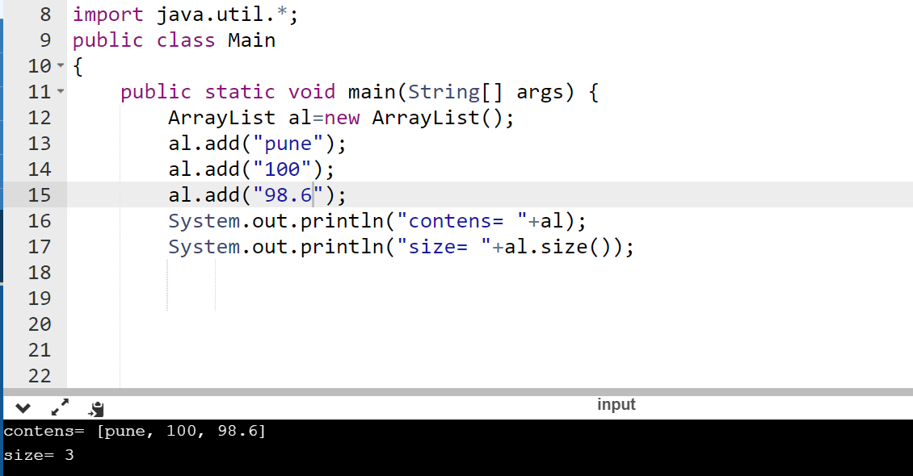

Slide 38
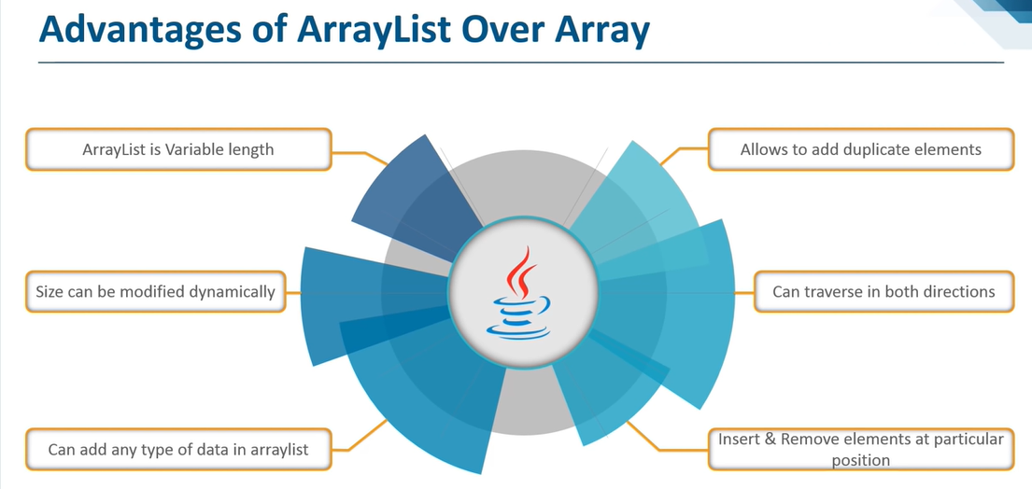

Slide 39
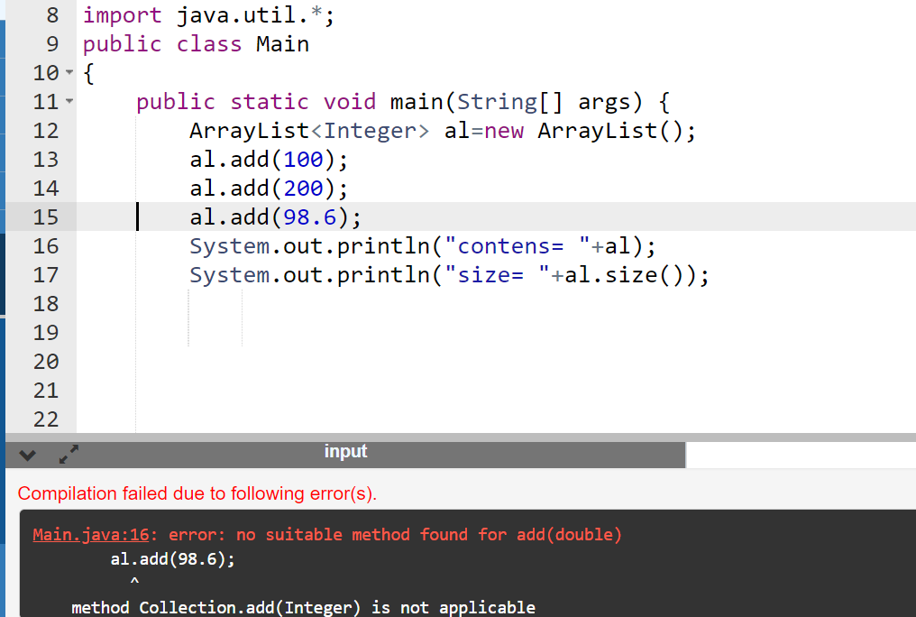

Slide 40
Linked Lists

Slide 41

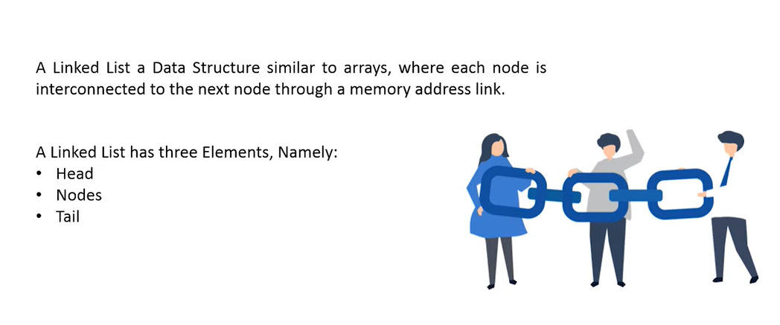

Slide 42
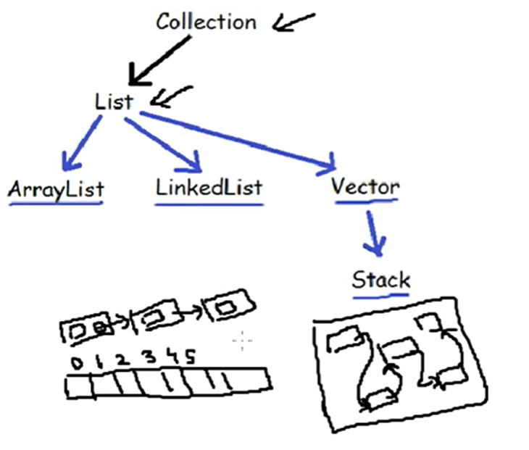

Slide 43
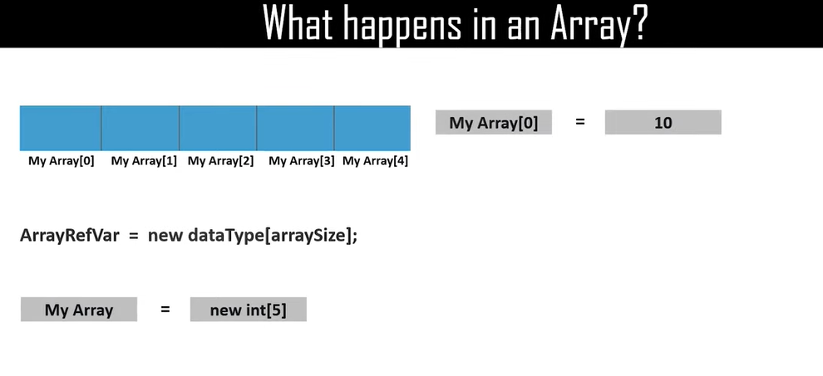

Slide 44
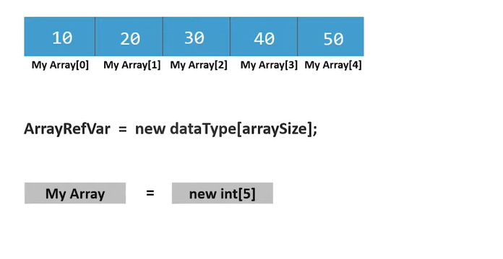

Slide 45
Node Structure
struct node
{
int data;
struct node *next;
};
node 1 node 2 node 3
Start
NULL

Slide 46

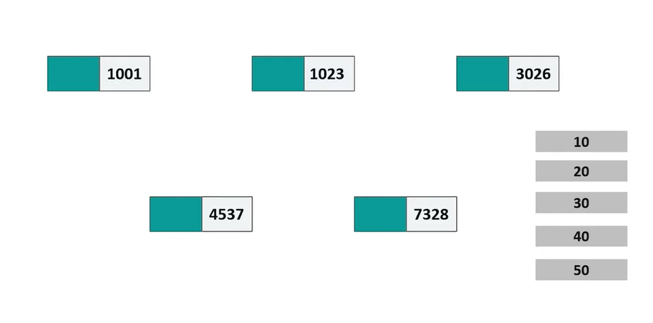

Slide 47
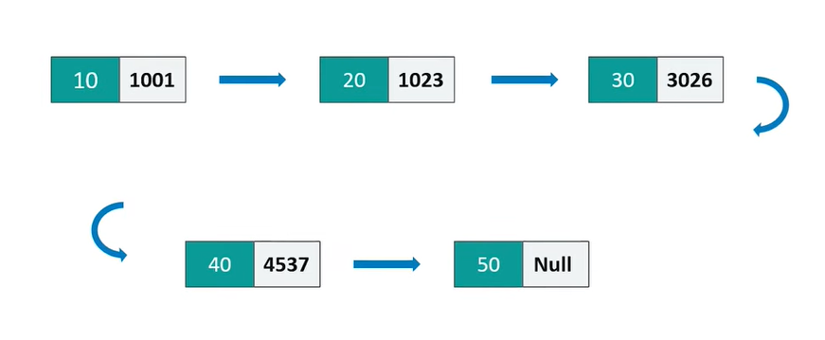

Slide 48
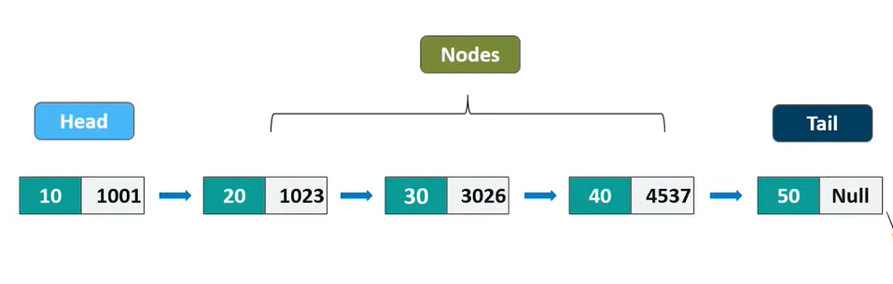

Slide 49
LinkedList
Similar to arrays in Java, LinkedList is a linear data structure. However LinkedList elements are not stored in contiguous locations like arrays, they are linked with each other using pointers.
Each element of the LinkedList has the reference(address/pointer) to the next element of the LinkedList.

Slide 50
List
The term “list” refers to a linear collection of data items such that there is a first element, second and …. A last element.
One way to store such lists is by means of arrays. Arrays use sequential mapping i.e. the data elements are stored in memory fixed distances apart. This makes it easy to compute the location of any element in the array.
However, arrays have certain disadvantages.

Slide 51
Limitations of Arrays
An array is a static data structure i.e. the size of the array remains fixed. Thus, even if the data structure actually uses less amount of storage to store elements or possibly no storage at all, the unutilized memory cannot be used for other purposes. Moreover, if more than the allotted space is required, it cannot be increased during runtime. (shortage/wastage of memory)
Most real-time applications process variable size data. Thus sequential mapping proves inadequate due to the reasons mentioned in 1.
Often, we need to insert and delete data. Insertion and deletion from the end is easy but in order to insert an element in between, the remaining elements will have to be shifted by one position. Even for deletion, the elements will have to be shifted one position before. This will require a lot of processing time.

Slide 52
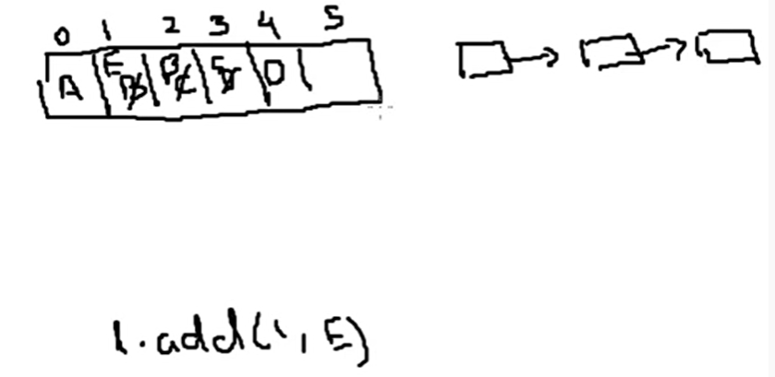

Slide 53
Comparison of a Sequential and Linked Memory organization
Sequential Organization | Linked Organization
Successive elements of list are stored at fixed distance apart. | Elements can be placed anywhere in the memory.
Provides static allocation of memory, which means space allocation, is done by compiler once cannot be changed during execution and size has to be known in advance. | Provides dynamic allocation of memory, which means space allocation, is done during execution and size need not be known in advance.
As individual objects are stored at fixed distance apart, we can access any element randomly. | As individual objects are not stored at fixed distance apart, we cannot access element randomly.
Insertion and deletion of objects in between the list requires a lot of data movement. | Insertion and deletion of objects in between the list require less data movement.
Element need not keep address of its successive element | Every element keeps address of its successive element.

Slide 54
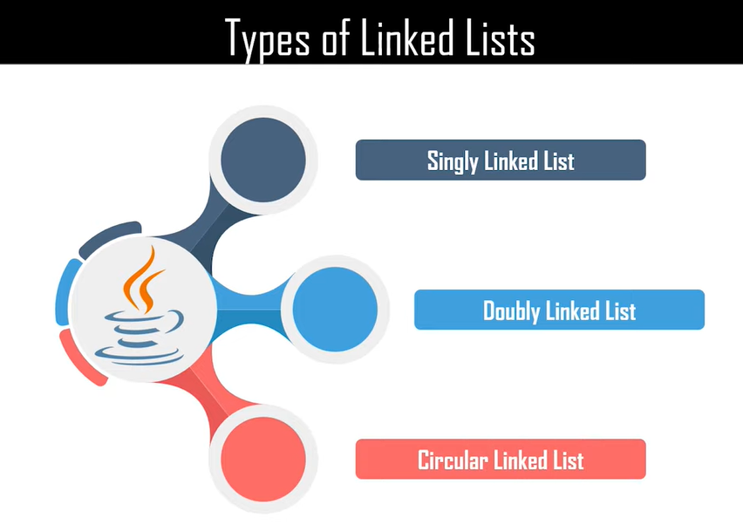

Slide 55
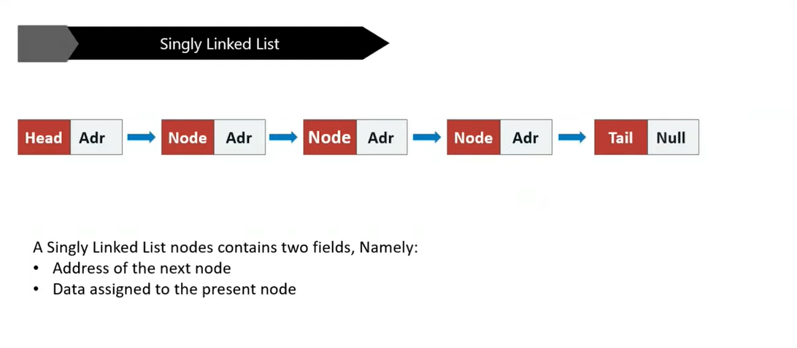

Slide 56
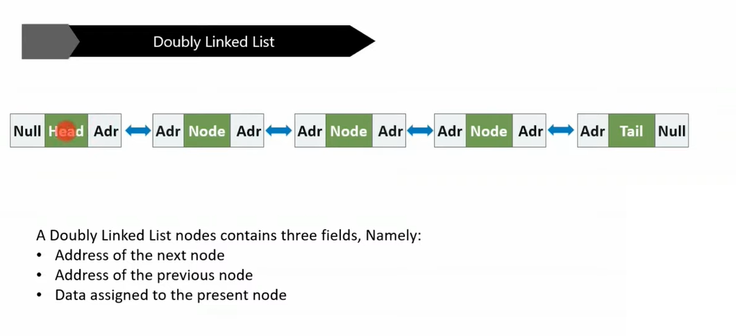

Slide 57
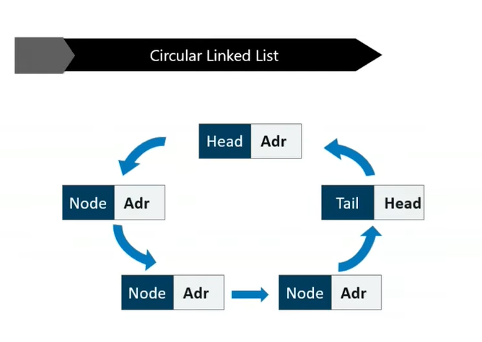

Slide 58
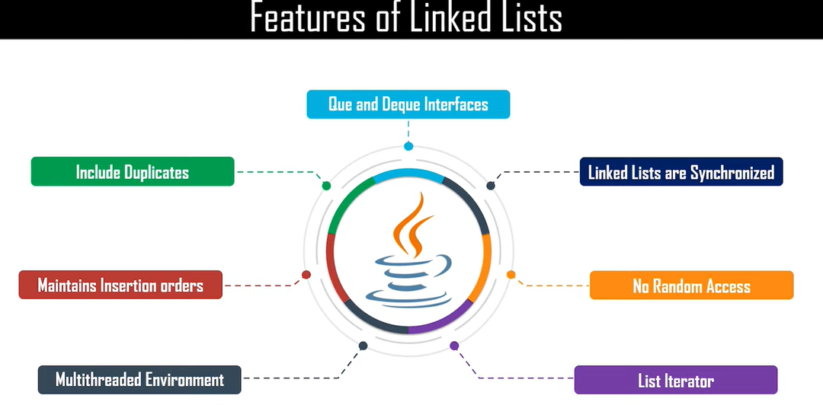

Slide 59
Linked List Operations
Basic operations:
Create
Display
Insert a node into the list
Delete a node from the list

Slide 60
Create a New Node
Allocate memory for the new node:
newnode = (node*) malloc(sizeof(node)); //C
newnode= new node; //C++
Initialize the contents of the node:
newnode->data = X
newnode->next = NULL;

Slide 61
struct node
{
int data;
struct node *next;
};

Slide 62
node *create(node *head)
{
char op;
node *newnode,*temp;
newnode=new node;
cout<<"\nEnter data=";
cin>>newnode->data;
newnode->next=NULL;
head=newnode;
temp=newnode;
do
{
cout<<"\nEnter data=";
newnode=new node;
cin>>newnode->data;
temp->next=newnode;
temp=newnode;
newnode->next=NULL;
cout<<"\nDo u want to continue=";
cin>>op;
}while(op=='y');
return head;
}

Slide 63
void display(node *head)
{
node *temp;
temp=head;
while(temp!=NULL)
{
cout<<temp->data<<"->";
temp=temp->next;
}
cout<<"NULL" ;
}

Slide 64
Inserting a Node Into a Linked List
3 cases
Insert at start
Insert in between
Insert at end

Slide 65
node* addbeg(node *head)
{
node *newnode,*temp;
temp=head;
newnode=new node;
cout<<"Enter data=";
cin>>newnode->data;
newnode->next=temp;
head=newnode;
return head;
}

Slide 66
node* addend(node *head)
{
node *newnode,*temp;
temp=head;
newnode=new node;
cout<<"Enter data=";
cin>>newnode->data;
while(temp->next!=NULL)
{
temp=temp->next;
}
temp->next=newnode;
temp=newnode;
return head;
}

Slide 67
node* addbet(node *head)
{
node *newnode,*temp;
temp=head;
newnode=new node;
cout<<"Enter after which node you have to add=";
cin>>key;
cout<<"Enter data";
cin>>newnode->data;
while(temp->data!=key)
{
temp=temp->next;
}
newnode->next=temp->next;
temp->next=newnode;
return head;
}

Slide 68
Deleting a Node
3 Cases
Delete the first node
Delete the last node
Delete in between node

Slide 69
node* delbeg(node *head)
{
node *temp;
temp=head;
head=head->next;
temp->next=NULL;
delete temp;
return head;
}

Slide 70
node* delend(node *head)
{
node *temp,*temp1;
temp=head;
temp1=temp->next;
while(temp1->next!=NULL)
{
temp=temp->next;
temp1=temp1->next;
}
temp->next=NULL;
delete temp1;
return head;
}

Slide 71
node* delbet(node *head)
{
node *temp,*temp1;
temp=head;
cout<<"After which node u have to delete";
cin>>key;
while(temp->data!=key)
{
temp=temp->next;
}
temp->next=temp->next->next;
return head;
}

Slide 72
int main()
{
node *head=NULL;
head=create(head);
display(head);
do
{
cout<<"1:Add\n2:Delete";
cin>>ch;
switch(ch)
{
case 1:
cout<<"Add first node";
head=addbeg(head); display(head);
cout<<"Add last node";
head=addend(head); display(head);
cout<<"Add node in between";
head=addbet(head); display(head);
break;

Slide 73
case 2:
cout<<"Delete first node";
head=delbeg(head);
display(head);
cout<<“Delete Last node";
head=delend(head);
display(head);
cout<<“Delete between node";
head=delbet(head);
display(head);
break;
}
cout<<"Do u want to continue=";
cin>>op;
}while(op=='y');
}

Slide 74
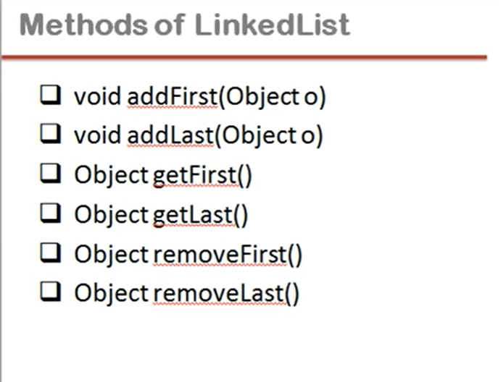

Slide 75


Slide 76


Slide 77


Slide 78
Contents
Exception: Errors, Types of Errors, Exception and its Types, Exception-Handling Fundamentals, Uncaught Exception, Using try and Catch, Multiple Catch Clauses, Nested Try Statements, User Define Exception using Throw.
Generics: What are Generics? Introduction to Language Specific Collection Interface: List Interface and Set Interface, Collection Classes: ArrayList Class and LinkedList Class.

Slide 79
Set Interface

Slide 81


Slide 82


Slide 83


Slide 84


Slide 85


Slide 86


Slide 87
List Interface

Slide 90


Slide 91


Slide 92


Slide 93
Case Study
1. Exception handling and generic programming using array list (ArrayList class).

Slide 94
Case Study
Description: Maintain an array list (ArrayList class) of characters with following operations:
Add
Display
Delete
Modify
Validate data type and throw exception.

Slide 95
Questions
Distinguish errors and exceptions. (Analyzing)
The user enters two numbers Num1 and Num2. The division of Num1 and Num2 is displayed. If Num1 and Num2 are not integers, the program would throw a Number Format Exception. If Num2 were zero, the program would throw an Arithmetic Exception. Display the exception. Apply the exception handling mechanism. (Applying)

